Slide 1
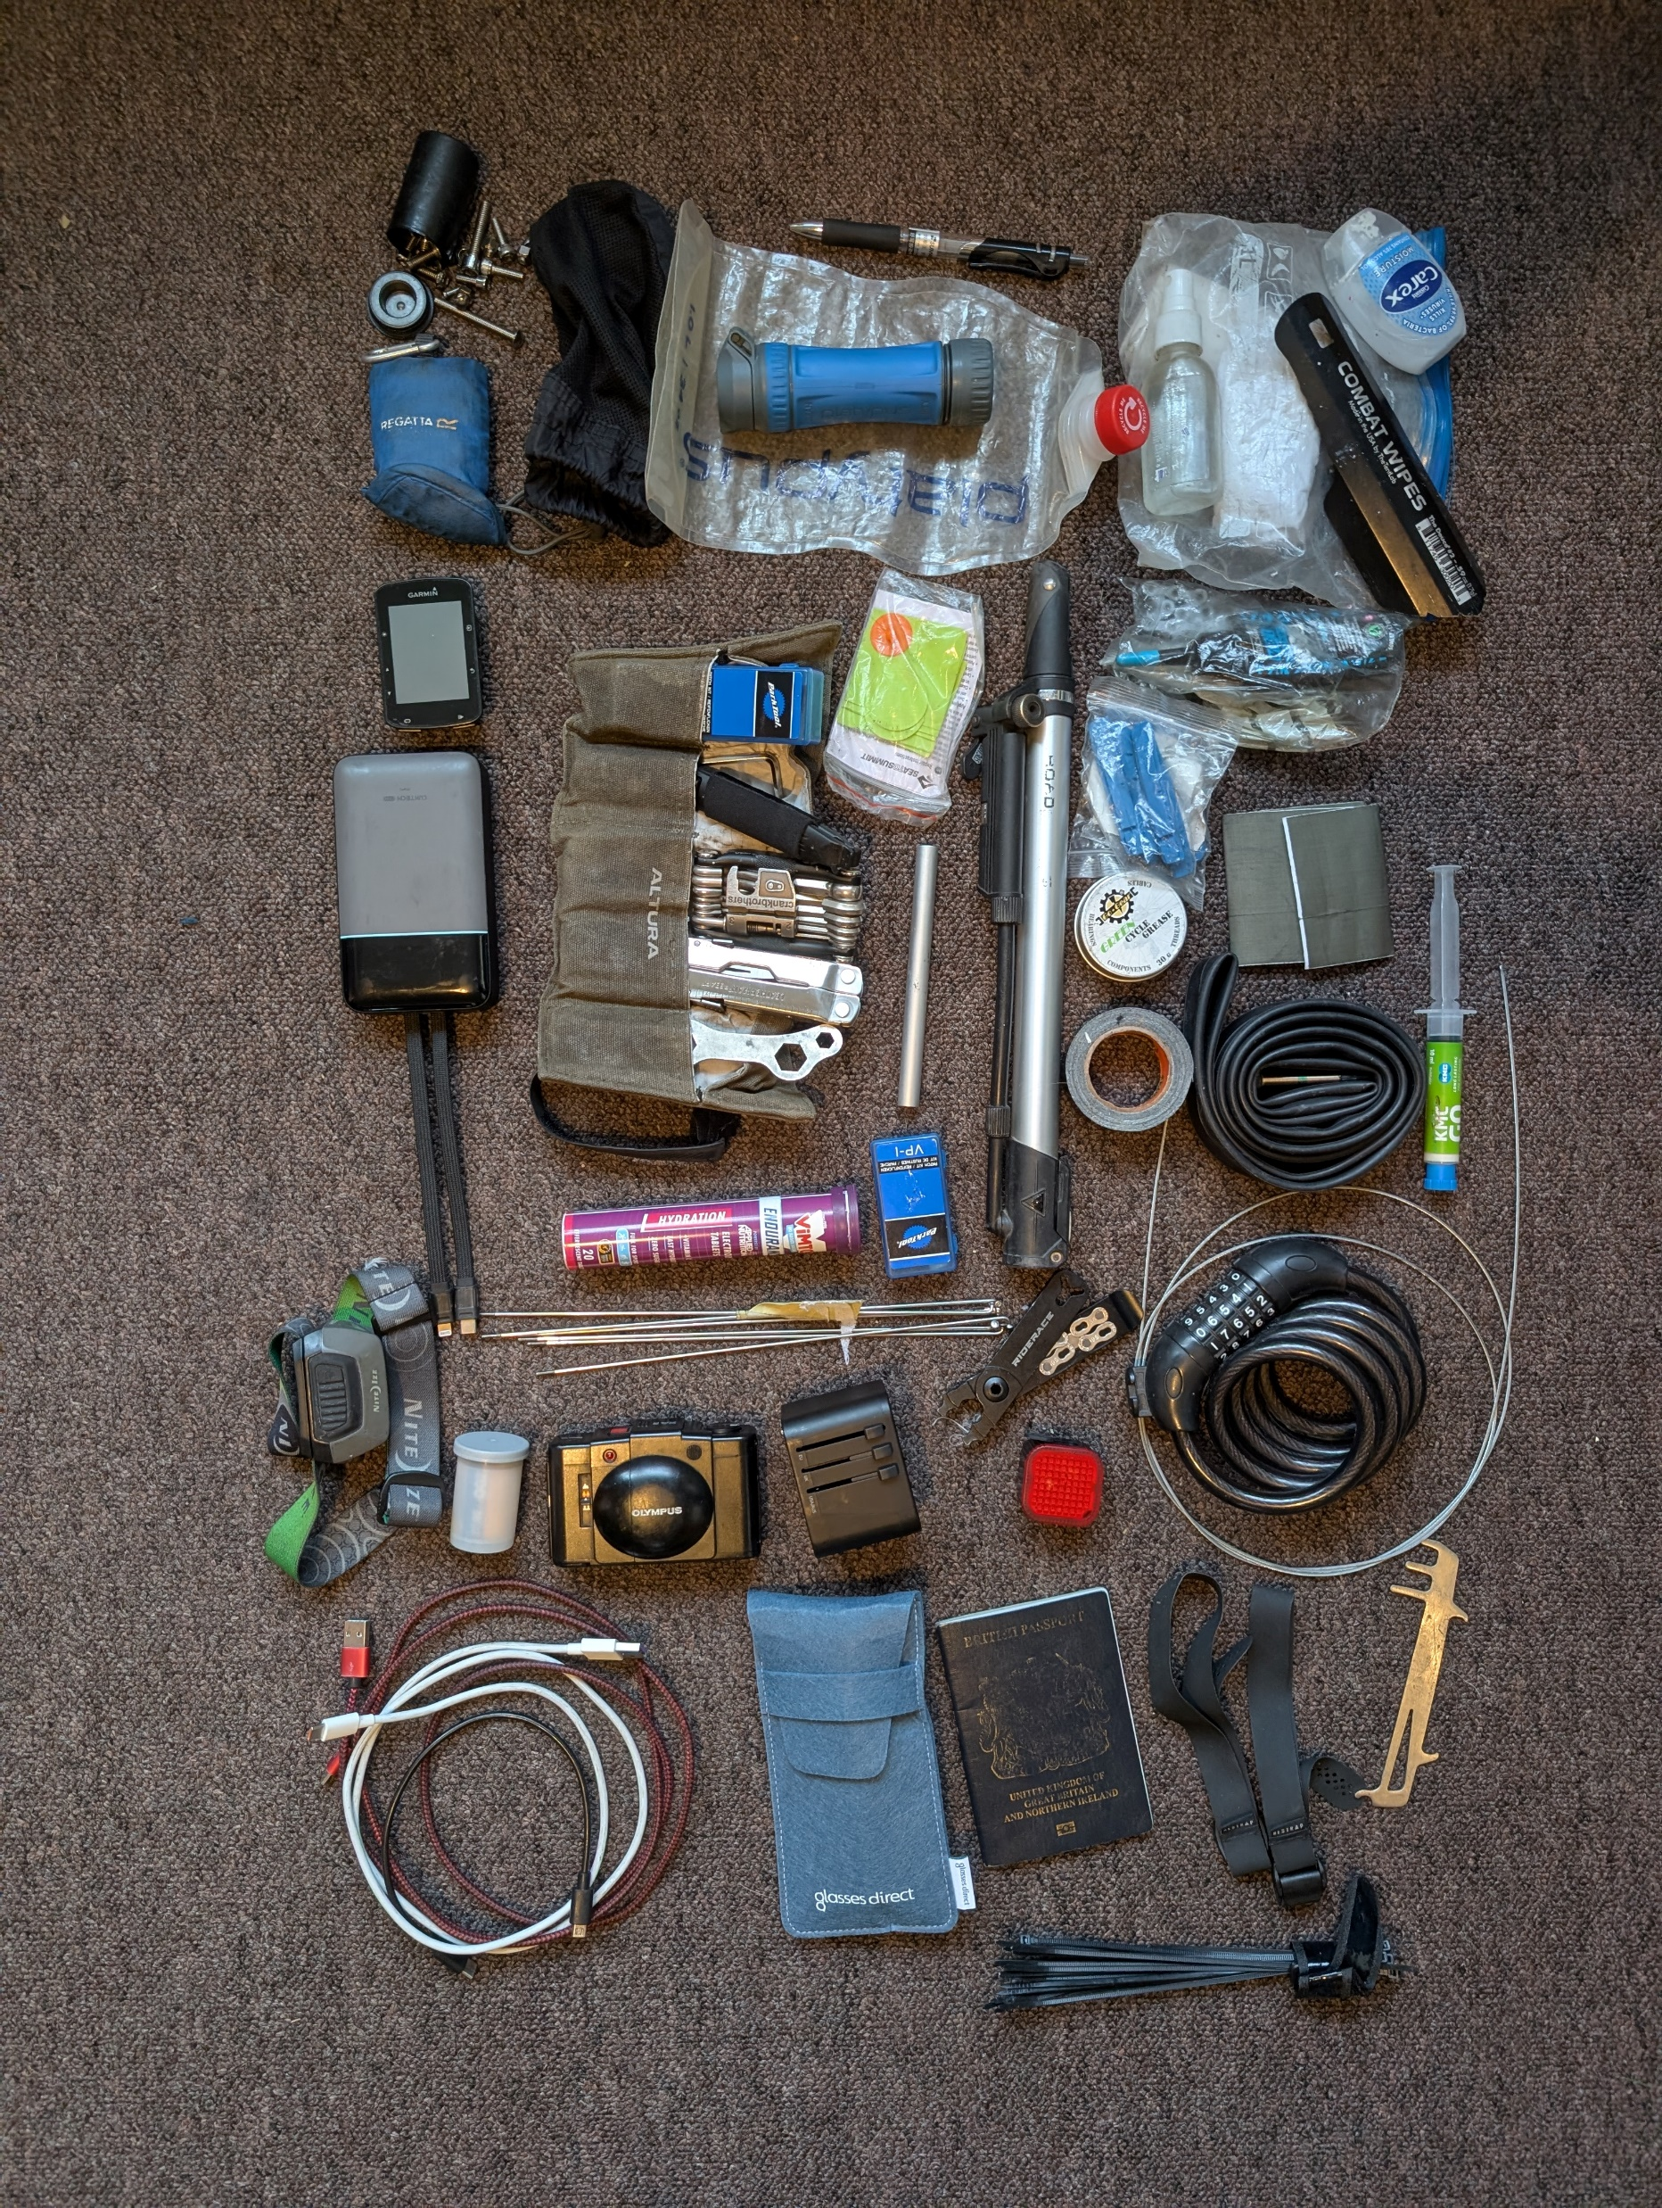
water filter
pen
wild toilet kit
spare bolts
microfibre cloth
trowel
pump
brake pads
puncture repair kit
cycling GPS
chain lube
powerbank
sleeping mat patches
tyre levers
tent patch material
multi-tool
leatherman
grease
rehydration tablets
pole splint
tape
chain wax
tube
head torch
spokes
chain pliers
brake cable
film roll
power adapter
rear light
lock
film camera
chain wear tool
charging wires
sunglasses+ case
passport
straps
zip ties

Slide 2
水过滤器
螺母和螺栓
笔
户外厕所套件
铲
超细纤维布
轮胎打气筒
刹车片
骑行 GPS
补胎工具包
链条润滑油
充电宝
睡垫补丁
撬胎棒
帐篷补片材料
多功能工具
莱特曼
润滑脂
链条蜡
补液片
帐篷杆夹板
重型胶带
内胎
头灯
刹车线
辐条
链钳
相机胶卷
后灯
旅行插头
锁
胶片相机
链条磨损工具
充电线
太阳镜+盒
拉链领带
护照
肩带

Slide 4
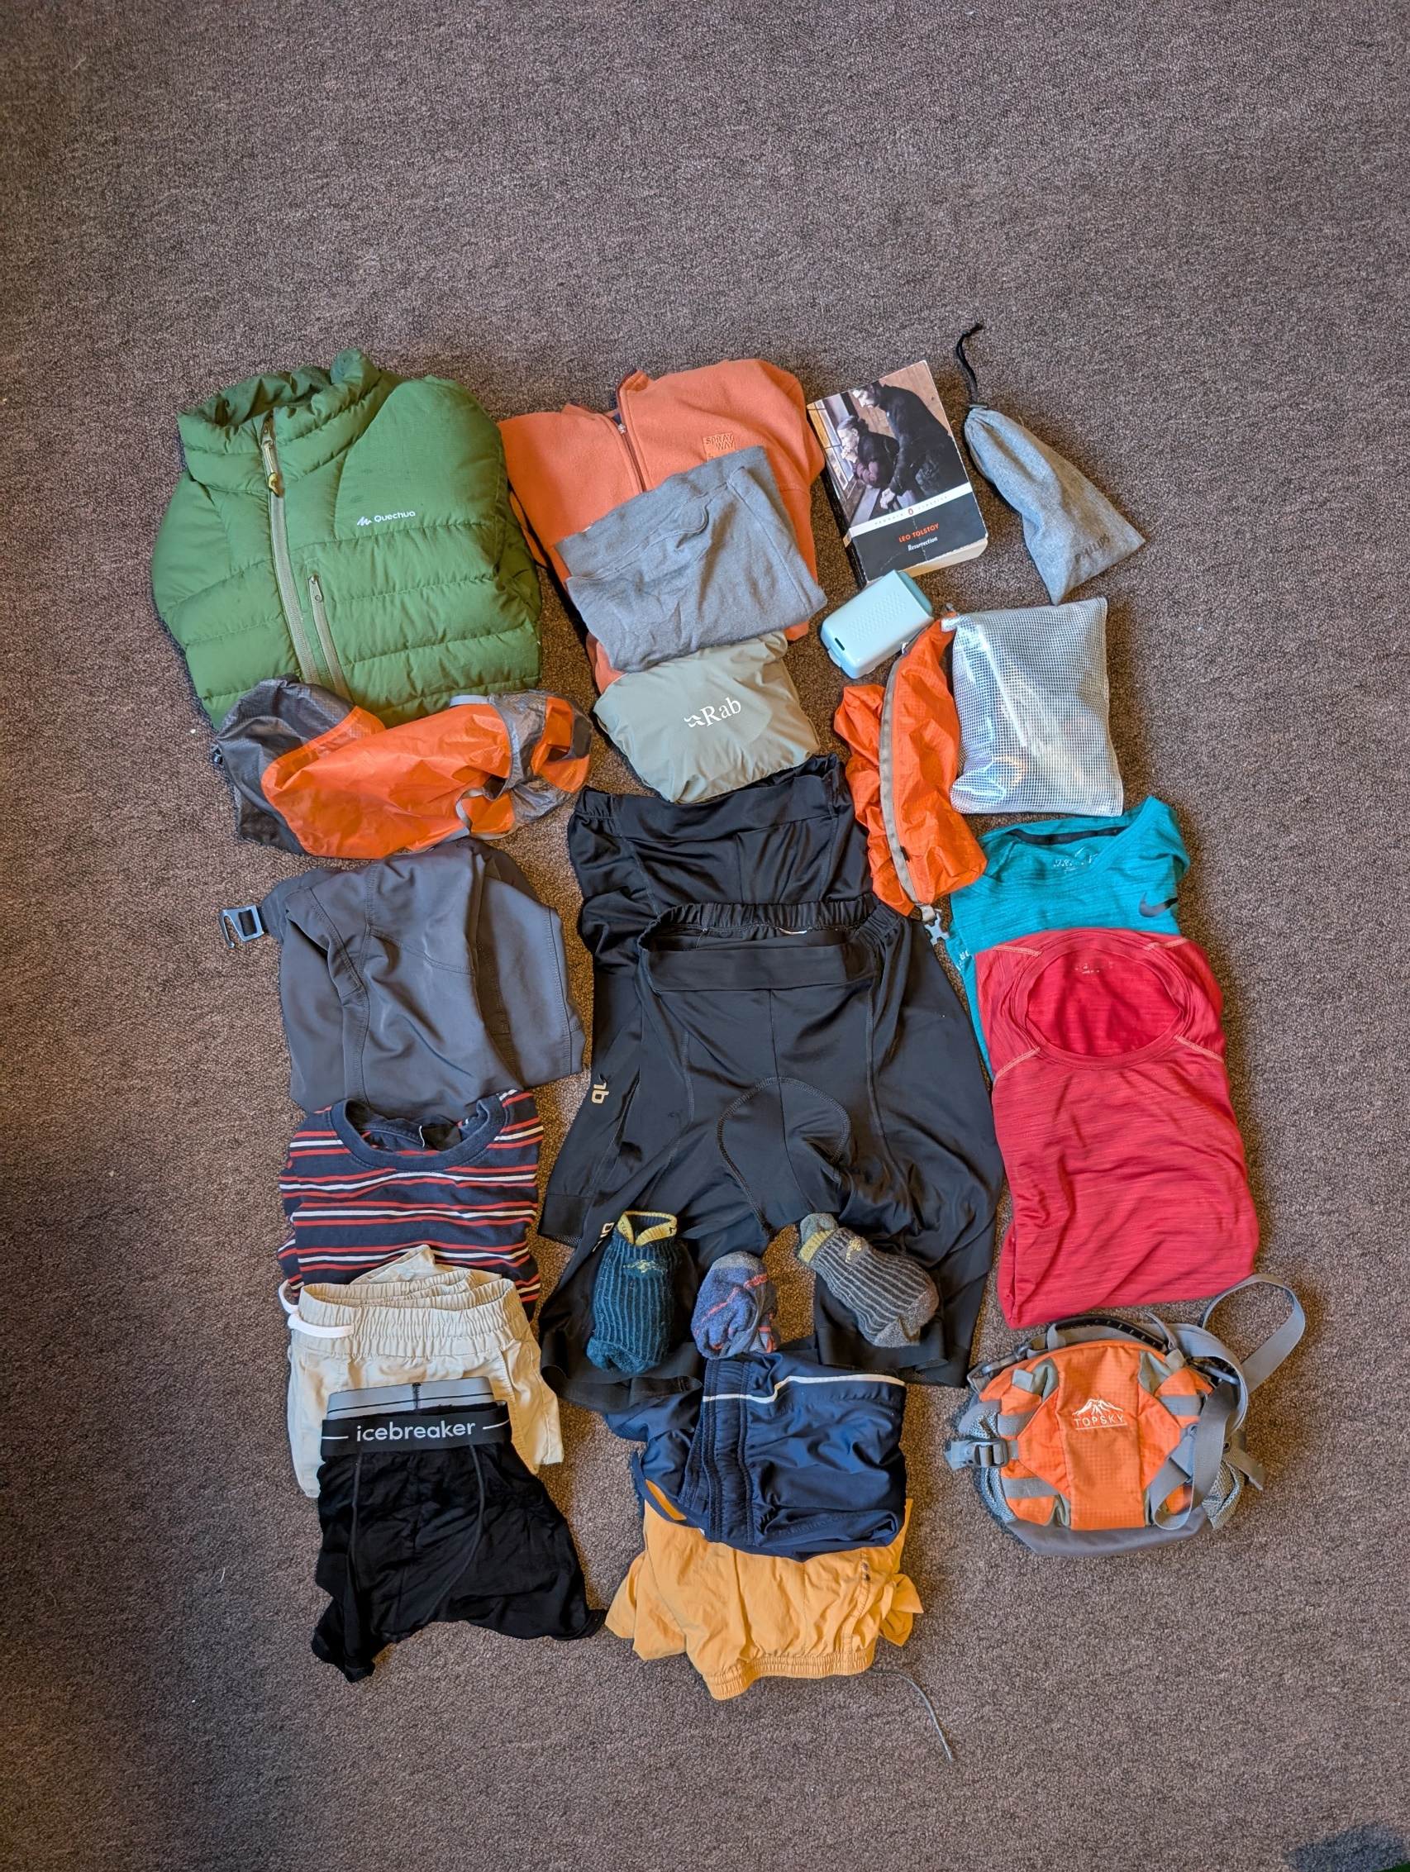
light mid-layer fleece
book
soap bar
Decathlon 0°C down jacket
Merino wool buff
electric shaver
Rab cinder waterproof jacket
bike repair tools + spares
compression sack (down jacket)
compression sack (clean clothes)
mountain biking trouser
sports t-shirts x2
day off shirt
Trail-running shoes (not pictured)
padded cycling shorts x2
day off shorts
bumbag
day off underwear x2
Darn Tough socks x3
sports shorts x2

Slide 5
轻薄中层抓绒
书
一块肥皂
迪卡侬0度羽绒服
美利奴羊毛水巾
电动剃须刀
Rab cinder 防水夹克
自行车维修工具/备件包
压缩袋（羽绒服）
用于装干净衣物的压缩袋
山地自行车裤
运动T恤x2
休息日T恤
越野跑鞋（图中未显示）
带衬垫的骑行短裤x2
休息日短裤
腰包
休息日内衣 x2
Darn Tough 袜子 x3
运动短裤 x2

Slide 7
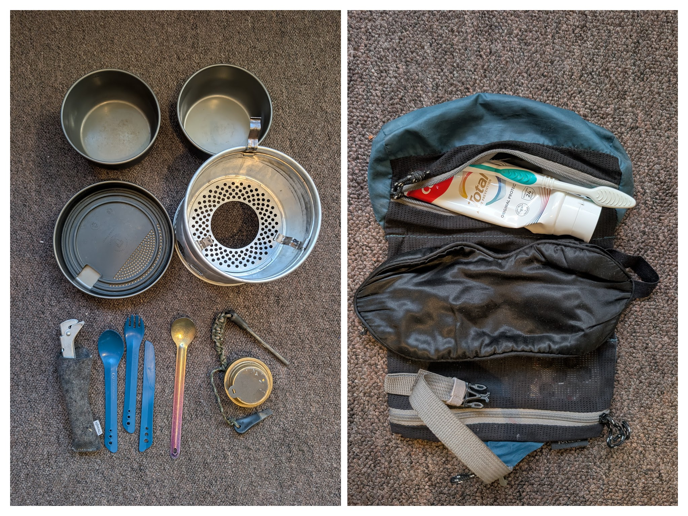
Trangia cooking set
Bathroom/sleep stuff
Sleep mask
Alcohol stove
Basic medicines

Slide 8
Trangia 炊具
浴室/睡眠用品
睡眠面膜
酒精炉
基本药物

Slide 10
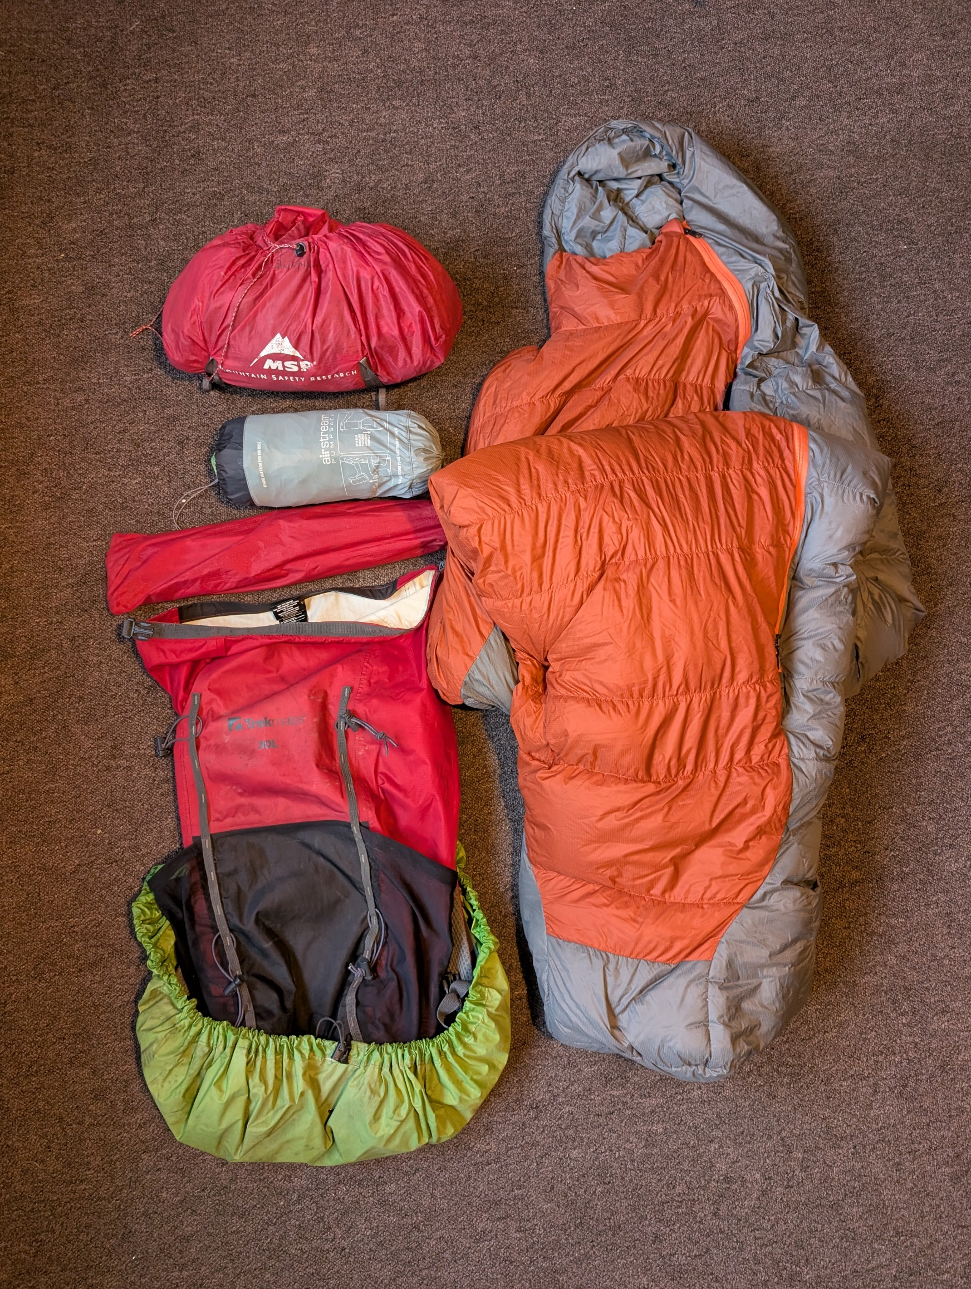
Sea-to-summit ether light xt sleeping mat
MSR Hubba NX tent
0C sleeping bag
Waterproof drysack backpack

Slide 11
Sea-to-summit ether light xt 睡垫
MSR Hubba NX 帐篷
0度睡袋
防水干袋背包

